Slide 1




Groups of humans and robots
Understanding membership preferences and team formation
Filipa Correia, Sofia Petisca, Patrícia Alves-Oliveira, Tiago Ribeiro, Francisco S.Melo, Ana Paiva

Slide 2
Motivation

Slide 3
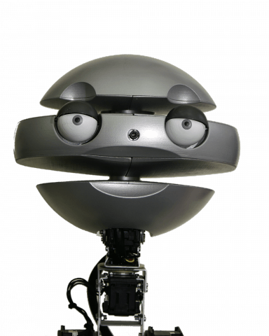

Slide 4
Why studying groups of humans and robots?
People’s behaviors change if exposed to other people…

Slide 5
Why studying groups of humans and robots?
People’s behaviors change if exposed to other people…
...studying these interactions in HRI is crucial!!!

Slide 6
Goals

Slide 7
Team formation
Membership preferences
Multi-party game context
Learning Goal Theory

Slide 8
Goals
Scenario and Characters

Slide 9
Sueca card game ♠♥♣♦
4 players
2 robots
2 humans
2 teams
Cooperative
Competitive

Slide 10
Sueca card game ♠♥♣♦
4 players
2 robots
2 humans
2 teams
Cooperative
Competitive

Slide 11
Learning Goal Theory
Performance-goal orientation
Learning-goal orientation

Slide 12
Learning Goal Theory
Performance-goal orientation
Learning-goal orientation
Creating two characters
Competitive
Relationship-driven
Emys
Glin

Slide 13
Goals
Hypothesis

Slide 14
Which robot will people prefer to partner with?
...and why?
H1: Participants will prefer the more relational robot (Glin)
Notes:
Learning-goal orientation is reported to have having high levels of backing up behaviours, high quality of the interaction and team commitment

Slide 15
Which robot will people prefer to partner with?
...and why?
H2: Participants’ competitiveness level robot choice
higher scores choosing the competitive robot (Emys)

Slide 16
Goals
Pipeline

Slide 17
How will we investigate it?
Development of the two characters
Validation for the characters behavior (Study 1)
Analysing preferences for team formation (Study 2)

Slide 18
Development of 2 characters

Slide 19
Issues:
Build two characters
Social behaviors
Playing capabilities
Interaction in a group (two autonomous robots!!!)

Slide 20
Social behaviours
Same embodiment but different voices!
Different utterances per character
Emys Glin
More competitive Relational perspective
e.g. supportive,
encouraging,
uttering hope
e.g. fostering the best score, blaming others

Slide 21
Social behaviours
Game State | Emys | Glin
End game - loss | “This cannot continue like this! You have to play better!” | “No worries partner, next time we will do better!”
Next player - partner | “Make a good play, we have to win this!” | “Even though it can be a difficult choice, I know you are going to make the right one.”
Playing | “Watch and learn how this is played.” | “I am so proud of being in your team!”

Slide 22
Playing capabilities
Same algorithm, however…
Element of chance
Different initial states
Different winning probabilities

Slide 23
Playing capabilities
Same algorithm, however…
Element of chance
Different initial states
Different winning probabilities
More natural and realistic
Hinders the task for any autonomous robots

Slide 24
Interaction in a group
Natural and believable human-like interaction
Turn taking!
Two-phase handshaking protocol
Intention of talking
Waiting for an answer

Slide 25
Study 1: Characters validation

Slide 26
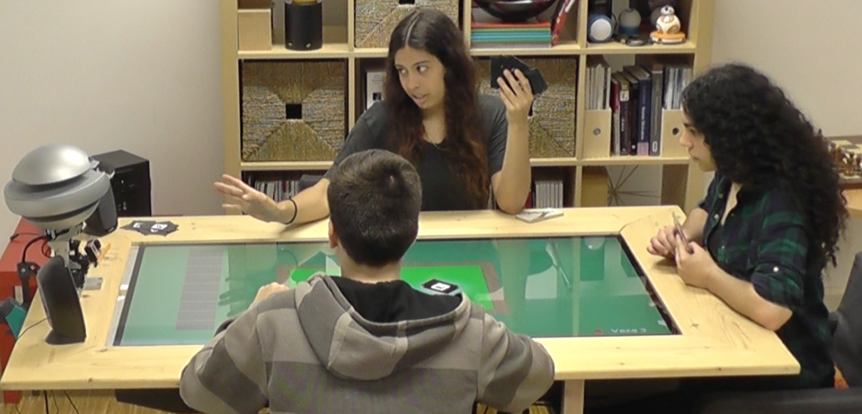
Study 1
30 participants

Slide 27
Measures
All in relation to the robotic player:
Competitiveness index
McGill Friendship Questionnaire
Help, Motivation, and Emotional security
Relationship Assessment Scale
Godspeed Questionnaire
Perceived intelligence, and Likeability

Slide 28
Results
Emys | Questionnaires dimensions | Glin
+ | Competitiveness index | -
- | Help | +
- | Motivation | +
- | Emotional Security | +
- | Relationship Assessment | +
- | Likeability | +
.. | Perceived Intelligence | ..

Slide 29
Results
Emys | Questionnaires dimensions | Glin
+ | Competitiveness index | -
- | Help | +
- | Motivation | +
- | Emotional Security | +
- | Relationship Assessment | +
- | Likeability | +
.. | Perceived Intelligence | ..

Slide 30
Results
Emys | Questionnaires dimensions | Glin
+ | Competitiveness index | -
- | Help | +
- | Motivation | +
- | Emotional Security | +
- | Relationship Assessment | +
- | Likeability | +
.. | Perceived Intelligence | ..

Slide 31

Results
Emys | Questionnaires dimensions | Glin
+ | Competitiveness index | -
- | Help | +
- | Motivation | +
- | Emotional Security | +
- | Relationship Assessment | +
- | Likeability | +
.. | Perceived Intelligence | ..

Slide 32
Study 2: Choosing a partner

Slide 33
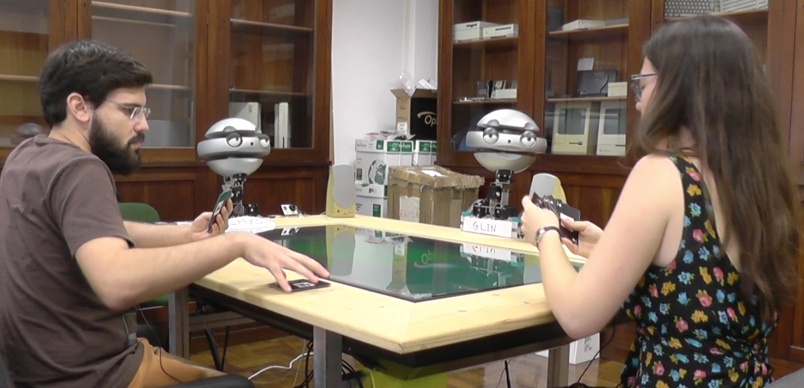
Study 2
61 participants (they did not know each other)

Slide 34
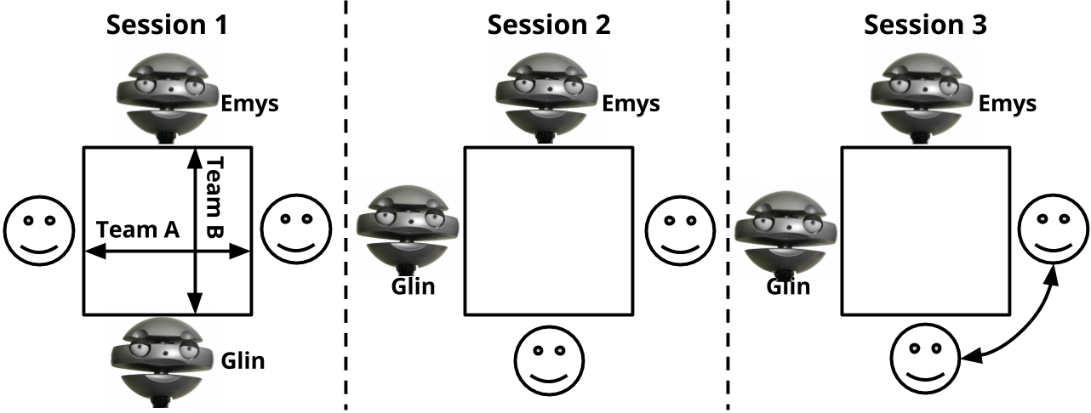
Measures
Demographics
Competitiveness of themselves

Slide 35
Measures
Godspeed of both robots
Choosing partner (Emys or Glin)

Slide 36
Measures
Godspeed of the last partner
McGill friendship of the last partner
Relationship assessment of the last partner

Slide 37
Measures
Godspeed of the last partner
McGill friendship of the last partner
Relationship assessment of the last partner
Choosing partner (Emys or Glin)

Slide 38
Measures
If you could choose one of the robots as partner,
which one would it be?

Slide 39
Results - First choice of robotic partner
Statistically significant difference
38 (63,3%) prefered Glin (relationship-driven)
22 (36,7%) prefered Emys (competitive)

Slide 40
Results - First choice of robotic partner
NOT Statistically significant difference
Competitiveness level of participants choosing Emys
Competitiveness level of participants choosing Glin

Slide 41
Results - First choice of robotic partner
Glin was the preferred robotic partner, and participants’ choices seemed to be guided by the different social behaviours.

Slide 42
Results - Last choice of robotic partner
NOT Statistically significant difference
35 prefered Glin (relationship-driven)
25 prefered Emys (competitive)

Slide 43
Results - Last choice of robotic partner
Statistically significant difference
Competitiveness level of participants choosing Emys
Competitiveness level of participants choosing Glin

Slide 44
Results - Last choice of robotic partner
Performance of the robot team
Statistically significant association
Choice of robot

Slide 45
Results - Last choice of robotic partner
There was no preferred robotic partner, although participants’ choices seemed to be influenced by their personal characteristics and the game result.

Slide 46
Conclusion

Slide 47
Before partnering with a robot…
Membership preferences in a competitive game context seemed to be influenced by the social behaviour of the robot.
After partnering with a robot...
Membership preferences in a competitive game context seem to be guided by personal characteristics and the team performance.

Slide 48
We believe our findings have an important implication for the creation of robot teammates in the HRI field.

Slide 49



Thank you!

